Slide 1


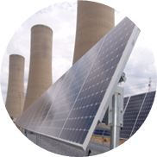
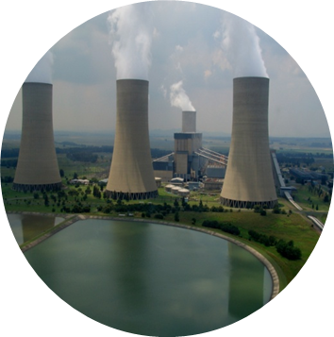
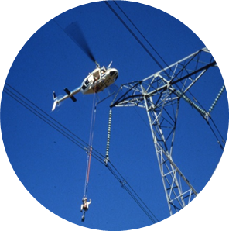
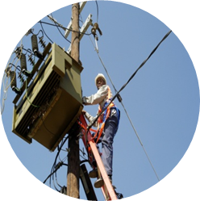
EIT Progress Review
Presented by: Teboho Richard Lekeno (4675468)
Mentor: Rishi Hariram
Coach: Tjaart Visser
Date: 10 December 2020
Qualification: BSc. Electrical Engineering
Studied: University of the Witwatersrand

Slide 2
Presentation Outline/Overview
Eskom Life Saving Rules
Engineer-in-Training timeline
Control & Automation
3. HV Plant
4. Remarks

Slide 3
Eskom Life Saving Rules
Rules
Rule 1 | Open, Isolate, test, earth, bond, and/or insulate before touch
Rule 2 | Hook up at heights
Rule 3 | Buckle up
Rule 4 | Be sober
Rule 5 | Ensure that you have a permit to work

Slide 4
Engineer-in-Training Timeline
HV Plant
HV Plant
(Sidwell Mtetwa)
3 month (Mar-Jun)
PTM&C
Control & Automation
(Tjaart Visser)
3 month (Sept-in progress)

Slide 5
Substation Control & Automation
Purpose
Monitor & control electrical system.
Both locally and remotely
Automates tedious, repetitive & operations
error => increase efficiency & productivity
PTM&C
Control & Automation
DC & Metering
Telecommunication
Protection
Control Applications
Project Engineering & Support

Slide 6
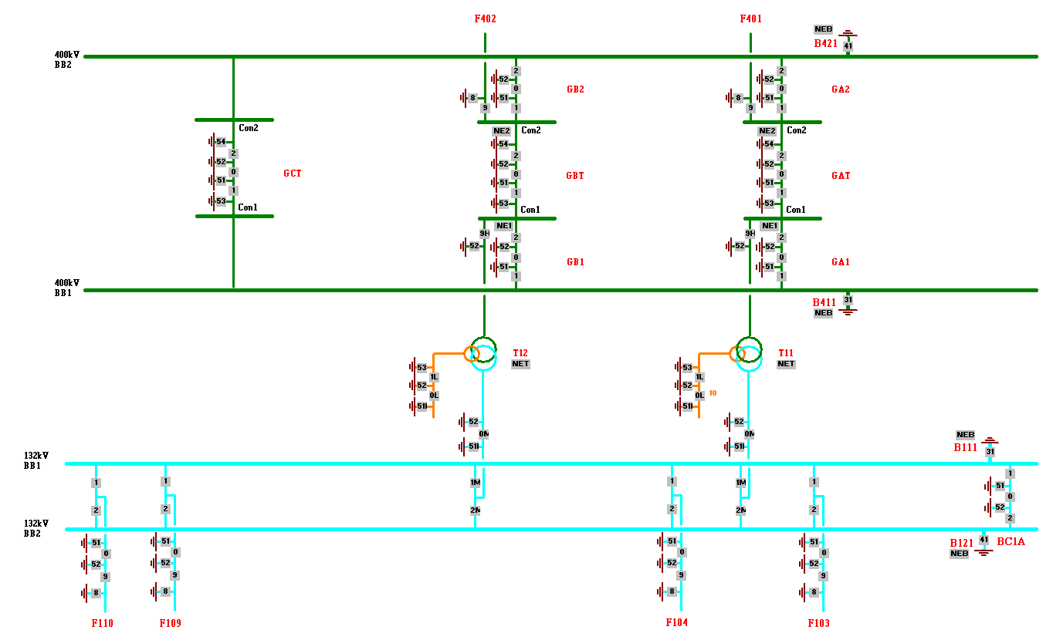
Interlocking Tool Project
Interlocking Objectives
1. Safety
2. Switching order
Level of Responsibility | ECSA Outcomes
Assisting | 5

Slide 7
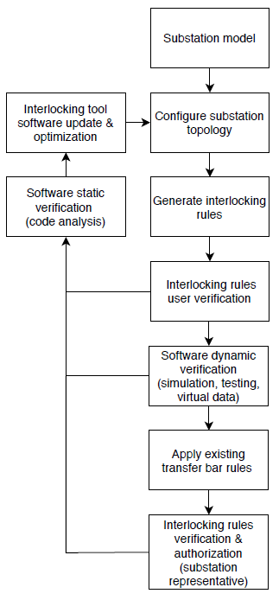
Interlocking Tool Tasks
Gather Business Cases
Compile Generic Interlocking Rules
Create Interlocking Rule Process
Flow Diagram

Slide 8
Other Activities
EADS App - Monitoring of CVT secondary voltages

Slide 9
Outcomes
SCADA equipment and technologies
SCADA and substation protocols, networking basics & HMI’s
Project Management
Interlocking
Teamwork

Slide 10
HV Plant
PDE
HV Plant
Planning & GIS
DBOUS
Line Engineering Service
Substation Engineering
PTM&C
System Integration
Purpose
Maintenance
Investigate failed transformer incidents to remaining & future transformers

Slide 11
Diagnosis of Gassing Transformer using Dissolve Gas Analysis
Detecting
Key-gas
Individual & Total Dissolved Key-Gas Concentration
Diagnosing
Rogers Ratio
Duval Triangle
IEC 60599 Edition 2
IEEE C57.104-1991
ABB, Service Handbook for Transformers, 2nd edition, p. 94-114
method | % correct diagnosis | % unresolved diagnosis | % wrong diagnosis
KGM | 42 | 0 | 58
RRM | 62 | 33 | 5
DTM | 96 | 0 | 4
Level of Responsibility | ECSA Outcomes
Participating | 4, 6, 8

Slide 12
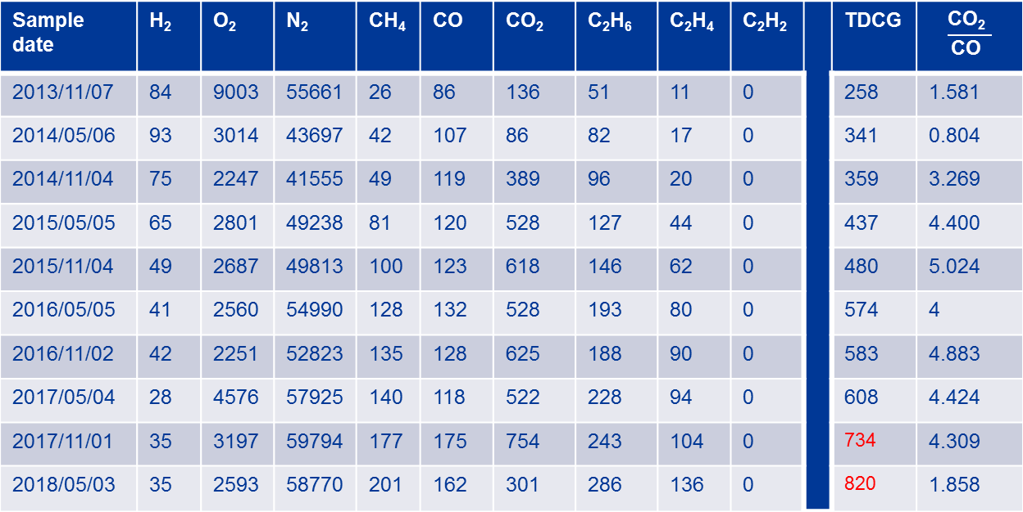
Fault Detection Using Individual & Total Dissolved Key-Gas Concentration Method
Sample date | H₂ | O₂ | N₂ | CH₄ | CO | CO₂ | C₂H₆ | C₂H₄ | C₂H₂ |  | TDCG | $$\frac{\text{C}\text{O}\text{2} }{\text{C}\text{O} }$$
2013/11/07 | 84 | 9003 | 55661 | 26 | 86 | 136 | 51 | 11 | 0 |  | 258 | 1.581
2014/05/06 | 93 | 3014 | 43697 | 42 | 107 | 86 | 82 | 17 | 0 |  | 341 | 0.804
2014/11/04 | 75 | 2247 | 41555 | 49 | 119 | 389 | 96 | 20 | 0 |  | 359 | 3.269
2015/05/05 | 65 | 2801 | 49238 | 81 | 120 | 528 | 127 | 44 | 0 |  | 437 | 4.400
2015/11/04 | 49 | 2687 | 49813 | 100 | 123 | 618 | 146 | 62 | 0 |  | 480 | 5.024
2016/05/05 | 41 | 2560 | 54990 | 128 | 132 | 528 | 193 | 80 | 0 |  | 574 | 4
2016/11/02 | 42 | 2251 | 52823 | 135 | 128 | 625 | 188 | 90 | 0 |  | 583 | 4.883
2017/05/04 | 28 | 4576 | 57925 | 140 | 118 | 522 | 228 | 94 | 0 |  | 608 | 4.424
2017/11/01 | 35 | 3197 | 59794 | 177 | 175 | 754 | 243 | 104 | 0 |  | 734 | 4.309
2018/05/03 | 35 | 2593 | 58770 | 201 | 162 | 301 | 286 | 136 | 0 |  | 820 | 1.858

Slide 13
Fault Detection Using Individual & Total Dissolved Key-Gas Concentration Method Continue
Sample date | Status
2013/11/07 | Condition 1: Operating satisfactorily
2014/05/06 | Condition 1: Operating satisfactorily (C2H6 should be investigated, exceed limits)
2014/11/04 | Condition 1: Operating satisfactorily (C2H6 should be investigated, exceed limits)
2015/05/05 | Condition 1: Operating satisfactorily (C2H6 should be investigated, exceed limits)
2015/11/04 | Condition 1: Operating satisfactorily (C2H6 & C2H4 should be investigated, exceed limits)
2016/05/05 | Condition 1: Operating satisfactorily (C2H6 & C2H4 should be investigated, exceed limits)
2016/11/02 | Condition 1: Operating satisfactorily (C2H6 & C2H4 should be investigated, exceed limits)
2017/05/04 | Condition 1: Operating satisfactorily (C2H6 & C2H4 should be investigated, exceed limits)
2017/11/01 | Condition 2: A fault may be present (C2H6 & C2H4 should be investigated, exceed limits)
2018/05/03 | Condition 2: A fault may be present (C2H6 & C2H4 should be investigated, exceed limits)

Slide 14
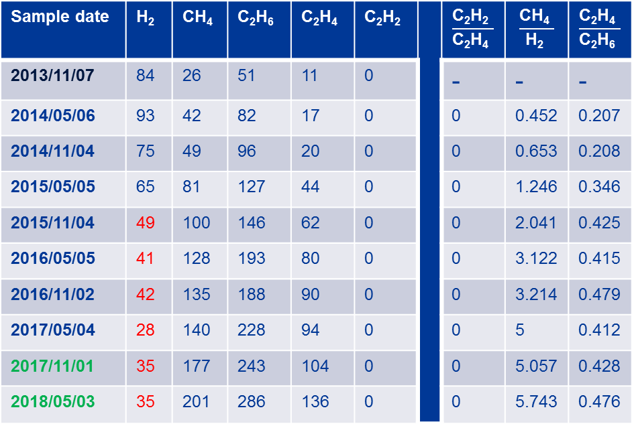
Fault Analysis Using Rogers Ratio Method
Sample date | H₂ | CH₄ | C₂H₆ | C₂H₄ | C₂H₂ |  | $$\frac{\text{C}\text{2}\text{H}\text{2} }{\text{C}\text{2}\text{H}\text{4} }$$ | $$\frac{\text{CH}\text{4} }{\text{H}\text{2} }$$ | $$\frac{\text{C}\text{2}\text{H}\text{4} }{\text{C}\text{2}\text{H}\text{6} }$$
2013/11/07 | 84 | 26 | 51 | 11 | 0 |  | - | - | -
2014/05/06 | 93 | 42 | 82 | 17 | 0 |  | 0 | 0.452 | 0.207
2014/11/04 | 75 | 49 | 96 | 20 | 0 |  | 0 | 0.653 | 0.208
2015/05/05 | 65 | 81 | 127 | 44 | 0 |  | 0 | 1.246 | 0.346
2015/11/04 | 49 | 100 | 146 | 62 | 0 |  | 0 | 2.041 | 0.425
2016/05/05 | 41 | 128 | 193 | 80 | 0 |  | 0 | 3.122 | 0.415
2016/11/02 | 42 | 135 | 188 | 90 | 0 |  | 0 | 3.214 | 0.479
2017/05/04 | 28 | 140 | 228 | 94 | 0 |  | 0 | 5 | 0.412
2017/11/01 | 35 | 177 | 243 | 104 | 0 |  | 0 | 5.057 | 0.428
2018/05/03 | 35 | 201 | 286 | 136 | 0 |  | 0 | 5.743 | 0.476

Slide 15
Fault Analysis Using Rogers Ratio Method Continue
Sample date | H₂ | CH₄ | C₂H₆ | C₂H₄ | C₂H₂ |  | Fault Type | Problem found
2013/11/07 | 84 | 26 | 51 | 11 | 0 |  | - | -
2014/05/06 | 93 | 42 | 82 | 17 | 0 |  | No fault | -
2014/11/04 | 75 | 49 | 96 | 20 | 0 |  | No fault | -
2015/05/05 | 65 | 81 | 127 | 44 | 0 |  | Thermal F 150-300°C | -This issue could be stray flux in the tank. -overheating of copper conductor from eddy current -This issue involves cellulose insulation, which will produce CO and CO₂
2015/11/04 | 49 | 100 | 146 | 62 | 0 |  | Thermal F 150-300°C
2016/05/05 | 41 | 128 | 193 | 80 | 0 |  | Thermal F 150-300°C
2016/11/02 | 42 | 135 | 188 | 90 | 0 |  | Thermal F 150-300°C
2017/05/04 | 28 | 140 | 228 | 94 | 0 |  | Thermal F 150-300°C
2017/11/01 | 35 | 177 | 243 | 104 | 0 |  | Thermal F 150-300°C
2018/05/03 | 35 | 201 | 286 | 136 | 0 |  | Thermal F 150-300°C

Slide 16
Fault Analysis Using Duval Triangle Method
Sample date | CH₄ | C₂H₆ | C₂H₄ | C₂H₂ |  | ∆CH₄ | ∆C₂H₄ | ∆C₂H₂ | %CH₄ | %C₂H₄ | %C₂H₂
2013/11/07 | 26 | 51 | 11 | 0 |  | - | - | - | - | - | -
2014/05/06 | 42 | 82 | 17 | 0 |  | - | - | - | - | - | -
2014/11/04 | 49 | 96 | 20 | 0 |  | 7 | 3 | 0 | 70 | 30 | 0
2015/05/05 | 81 | 127 | 44 | 0 |  | 32 | 24 | 0 | 57.14 | 42.86 | 0
2015/11/04 | 100 | 146 | 62 | 0 |  | 19 | 18 | 0 | 51.35 | 48.65 | 0
2016/05/05 | 128 | 193 | 80 | 0 |  | 28 | 18 | 0 | 60.87 | 39.13 | 0
2016/11/02 | 135 | 188 | 90 | 0 |  | 7 | 10 | 0 | 41.18 | 58.82 | 0
2017/05/04 | 140 | 228 | 94 | 0 |  | 5 | 4 | 0 | 55.56 | 44.44 | 0
2017/11/01 | 177 | 243 | 104 | 0 |  | 37 | 10 | 0 | 78.72 | 21.28 | 0
2018/05/03 | 201 | 286 | 136 | 0 |  | 24 | 32 | 0 | 42.86 | 57.14 | 0

Slide 17
Fault Analysis Using Duval Triangle Method Continue
Sample date | CH₄ | C₂H₆ | C₂H₄ | C₂H₂ |  | Fault level
2013/11/07 | 26 | 51 | 11 | 0
2014/05/06 | 42 | 82 | 17 | 0
2014/11/04 | 49 | 96 | 20 | 0 |  | T2: thermal fault > 300°C, ≤ 700°C
2015/05/05 | 81 | 127 | 44 | 0 |  | T2: thermal fault > 300°C, ≤ 700°C
2015/11/04 | 100 | 146 | 62 | 0 |  | T2: thermal fault > 300°C, ≤ 700°C
2016/05/05 | 128 | 193 | 80 | 0 |  | T2: thermal fault > 300°C, ≤ 700°C
2016/11/02 | 135 | 188 | 90 | 0 |  | T3: thermal fault > 700°C
2017/05/04 | 140 | 228 | 94 | 0 |  | T2: thermal fault > 300°C, ≤ 700°C
2017/11/01 | 177 | 243 | 104 | 0 |  | T2: thermal fault > 300°C, ≤ 700°C
2018/05/03 | 201 | 286 | 136 | 0 |  | T3: thermal fault > 700°C

Slide 18
Other Tasks (HV Plant)
 | Attended investigation of transformer failure | Created tender evaluation criteria | Gathering of Nameplates information for 3 Eskom grids
Level of responsibility | Being Expose, Assisting | Participating | Assisting
ECSA Outcomes | 4 | 6, 8 | -

Slide 19
Outcomes
Monitoring of power transformer health
Problem analysis and solving (finding the root cause)
Teamwork

Slide 20
VALUE ADDED
VALUE ADDED TO ME
Project management
Networking
Transformer fault analysis
Work ethics
VALUE ADDED TO BUSINESS
Participation in the Interlocking project
Participation in the creation of evaluation criteria for bidders

Slide 21
THANK YOU

